Slide 1
Microservices and DevOps
DevOps and Container Technology
Security 101 - Authorization
Henrik Bærbak Christensen

Slide 2
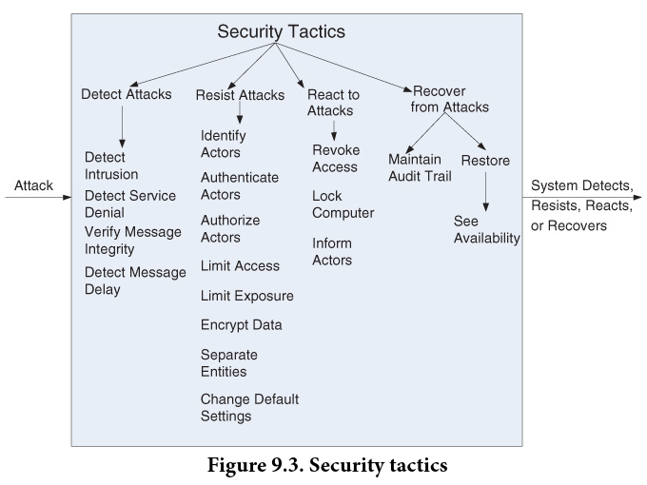
Authorization
Concerned with ability to protect data and information from unauthorized access while still providing access to people/systems that are authorized
Authenticate actor
Ok, you are Magnus
Authorize actor
… and you have access to SkyCave

Slide 3
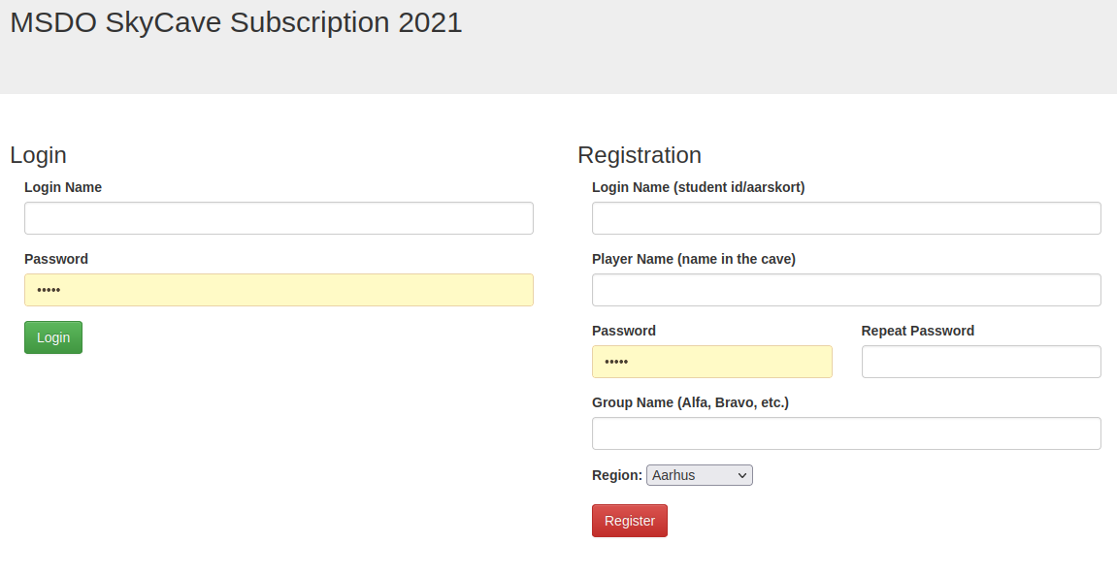
Our Backyard
You register credentials in the course subscription service…
‘Authenticate’
The daemon asks it during cave login
‘Authorize’

Slide 4
Architecturally
Then our daemon service must talk to the subscription service to authorize ‘Mathilde’
Simple, right?
Let Cmd send (loginName, password) to Daemon…
Deamon sends the (loginName, password) to AuthSrv and get a 200 OK or a 401 UNAUTHORIZED back?
Cmd
Daemon
Auth Server

Slide 5
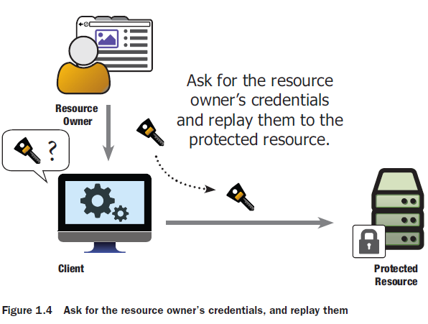
MSDO until 2021
This is actually exactly the way the SkyCave system operated up until 2021
The daemon would make a GET request on the subscription service…

Slide 6
The Issue
The problem is: Now Daemon has your credentials. It can impersonate you in other contexts.
In a growing web of services, it means your credentials are spread over an ever increasing set of services…
This does not really appear secure, does it?
And you have to keep track of credentials for numerous services
Each having their own database of credentials
☹

Slide 7
The Solution
Delegate the authorization to a AuthServer
I.e. you provide credentials to the AuthSrv, not the resource you want to access
The AuthSvr issues an AccessToken that is returned to the client (if you are authorized, of course)
Basically a unique ‘thing’ that states ‘you may use the resource’
From now on, all communication client-to-resource includes that token
The resource can always verify that the token is valid by requesting the AuthSvr
And – it expires…

Slide 8
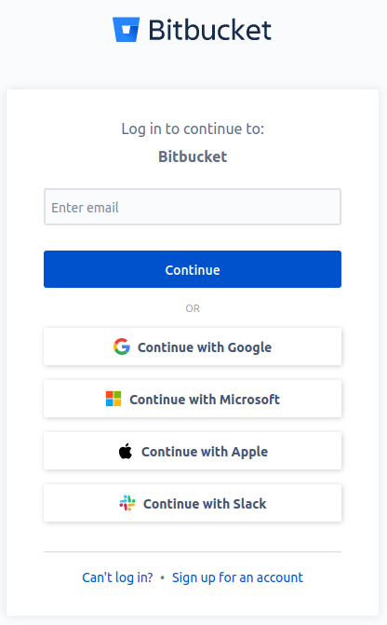
Example

Slide 9
(Privacy)
As a sidenote, privacy is quite another quality attributes
If you use Google as AuthSrv, then Google knows exactly which services you access and when…

Slide 10
Authentication
The OAuth 2 Dance
It is a protocol !
And it is a HTTP protocol…

Slide 11
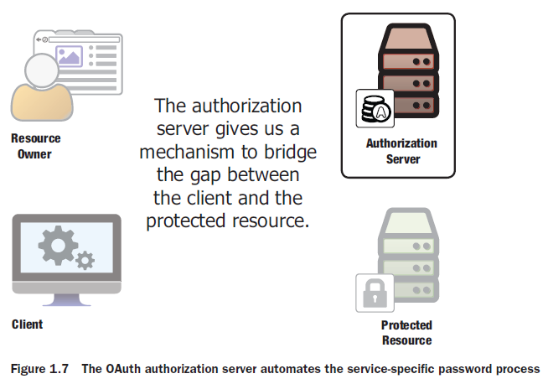
Terminology
The terms takes a bit of getting-used-to…
Resource Owner
That is me
Protected Resource
That is my bank account
Client
That is the bank’s web site
Authorization Server
That is NemID or …

Slide 12
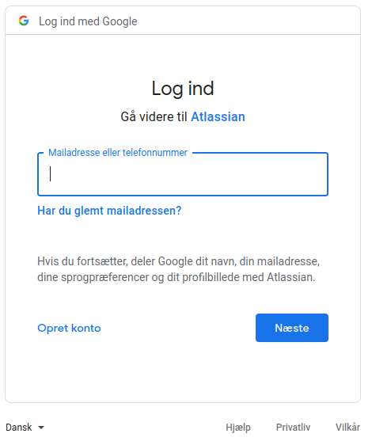
Exercise
I need access to my BitBucket account
Who is who here?

Slide 13
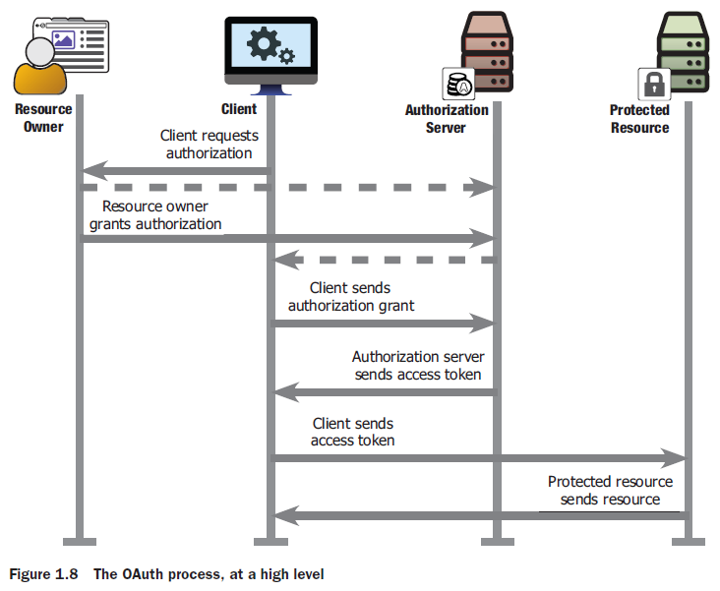
Helicopter Perspective
Overall…

Slide 14
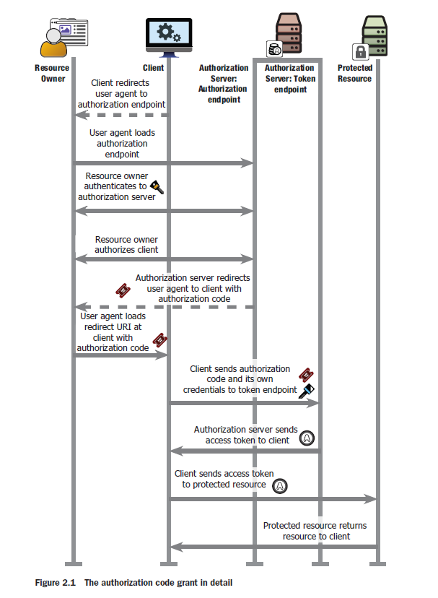
And the details…
Note the redirects…
OAuth is a protocol relying on the web and HTTP

Slide 15
The Details

Slide 16
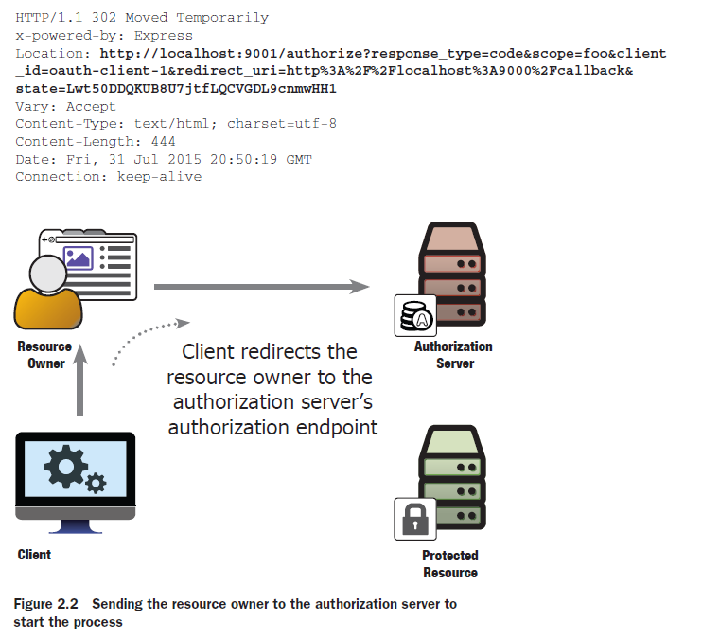
Authorization Grant
The OAuth Dance
Press ‘login’ make a redirect as answer
Forcing my browser to …
In the code:
9000 is the client
9001 is the AuthSvr
9002 is Protected Resource

Slide 17
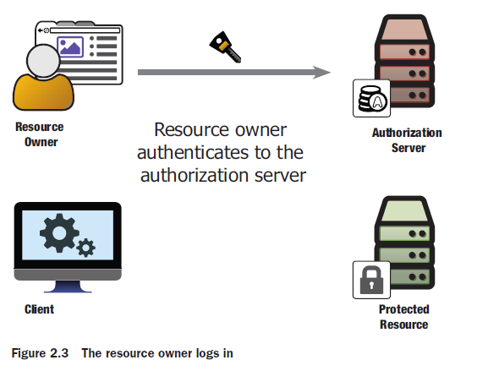
Redirect
… load the login page
Follow the requested redirect to the AuthServer
Now the resource owner logs in…

Slide 18
Back to client
AuthSrv redirect user back to client
… forcing the browser to request the client
… on the client’s /callback route
(which must be defined for client to be OAuth compliant…)
The authorization code is a one-time token
Authorization code

Slide 19
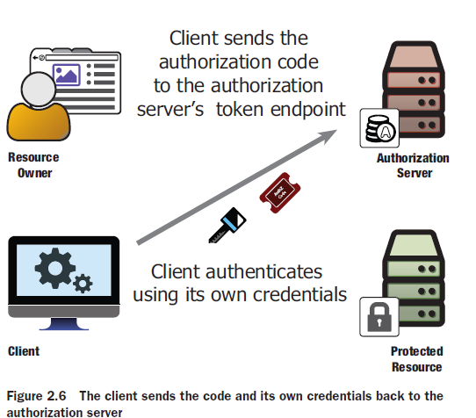
Call AuthSrv
Client presents ‘auth code’ to AuthSrv using POST
Note: The client also presents its own credentials , so the AuthSrv can ensure it is talking with a valid client
I.e. the client app must in advance be registered in the AuthSrv!

Slide 20
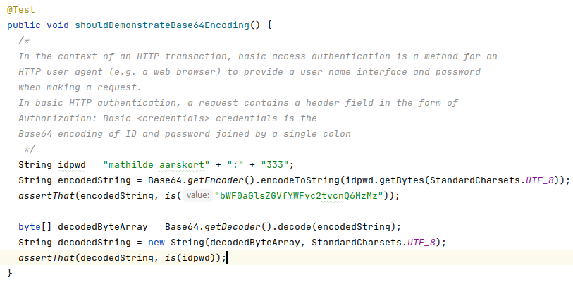
(Side Note)
Http basic access authentication (Wikipedia)
Java has library support for Base64

Slide 21
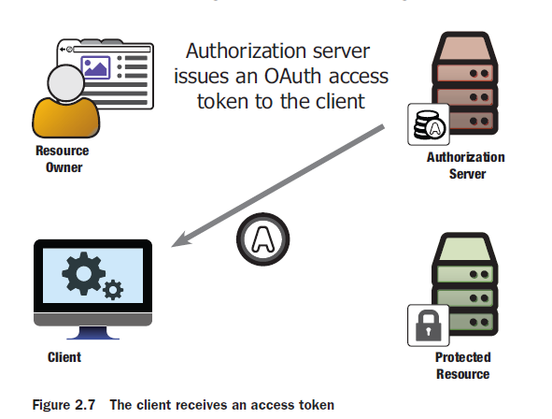
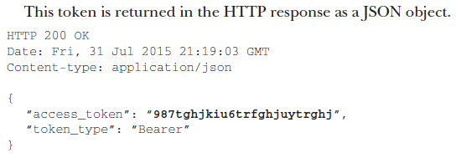
To finally get Access Token
The reply of the POST /token
This token embody This user is authorized and must be presented to all future calls to the Protected Resource
That is, ‘Client’ must cache this token

Slide 22
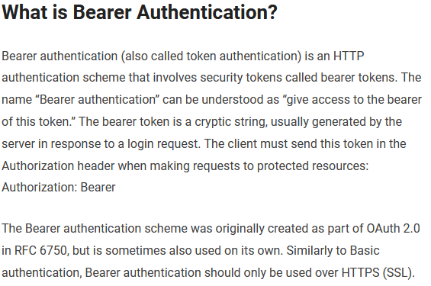
Access Token Use
That is, all future calls to protected resource are like:
I.e. a bearer token in HTTP terms
‘the bearer of this token has access to…’
Like the card employees carry with them inside company buildings…
Notes:
Source: https://www.devopsschool.com/blog/what-is-bearer-token-and-how-it-works/ (June 2021)

Slide 23
The Access Token
The access token is just a unique, opaque, bitstring
But returned answer may include a lot of more info
Scope, expiration time, refresh token
Or you can encode info in the token itself
JSON Web Token (JWT)

Slide 24
Protected Resource
So, the PR receives the token in each request
Must of course verify that it is a valid token!
And cache it to speed things upon on next requests…
May also include scopes, that is limit access to certain resources

Slide 25
Phew…
The process to get the access token is a two step protocol
1. Get the one-time authorization code
GET /authorize
2. Use client credentials + authorization code to get access token
POST /token
Once the access token is provided the AuthSvr is not involved

Slide 26
Separation of Concerns
Note that the client does not care how the AuthSvr does the authentication
It is fully delegated and the client is not involved
I can change my password and/or enable two-factor authentication
Loose coupling

Slide 27
Validating the Access Token
The Protected Resource’s view

Slide 28
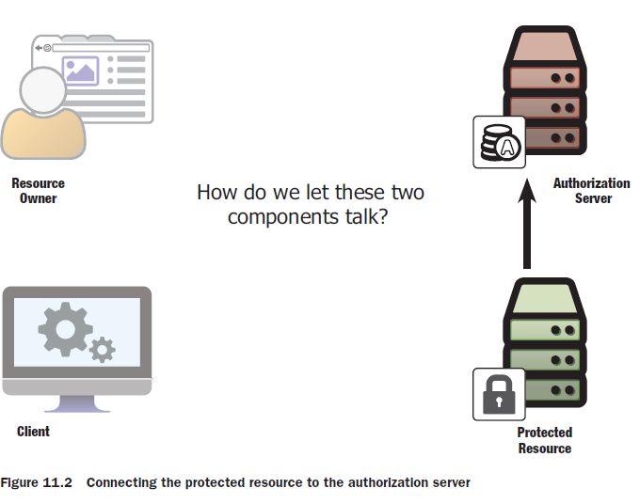
Issue
The PR is requested with an access token
But how does the PR know that it is valid? And that it represents user A and not user B?
And what scopes have the user rights to access?

Slide 29
Solutions
The simplest and often not possible solution…
Obviously not relevant if we are using Google as AuthSvr!
The other solution
The inspection protocol

Slide 30
Introspection protocol
The AuthSvr provides the ability to validate the token
Is this token valid? What is the resource owner involved?
Again, this client must have been registered and present its credentials , and of course also present the token, that must be validated…

Slide 31
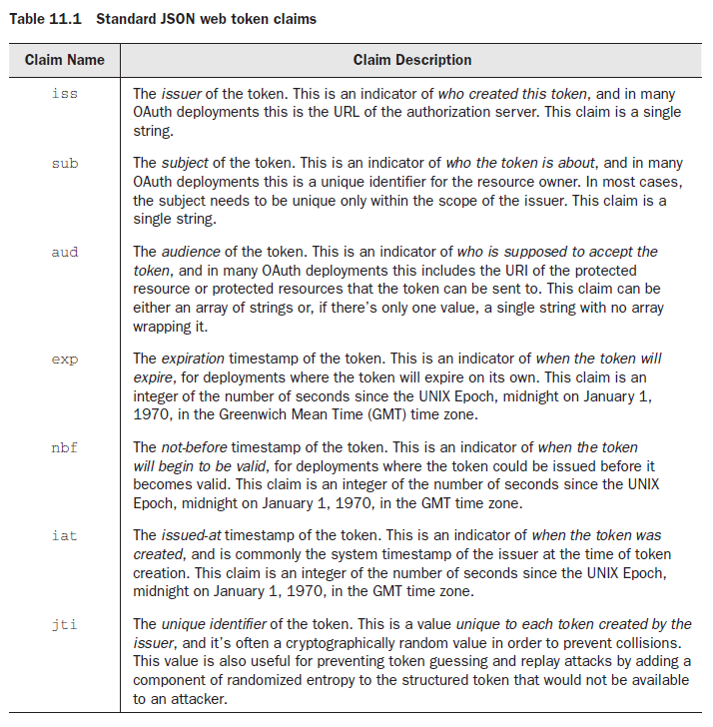
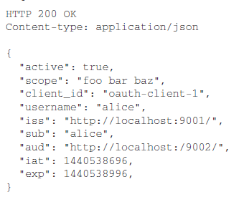
Introspection Reply
Reply is a description of the token
Actually a JavaWebToken, JWT
Or you get 401 UNAUTHORIZED

Slide 32
Downstream Usage
The inspection protocol is essential in a microservice context…
A ‘front’ service may pass the access token on to a downstream service
Which needs to verify the request is secure to perform
It can therefore always contact the AuthSvr to verify the received token (and cache it for further requests).
Cmd
Daemon
Cave Service
Magnus is Authorized
Magnus is Authorized???

Slide 33
SkyCave Adaption

Slide 34
SkyCave Simplifications
SkyCave is not a web based system, but Broker based
Redirects and stuff do not apply
SkyCave is (already) a legacy system
The ‘daemon’ is the ‘API Gateway’ = single point of entry
That is, the client does send credentials to the daemon
Design decision:
Keep the present centralized design
Client sends credentials to daemon
Daemon asks subscription service (AuthSvr) to authorize
Refactoring to a more correct design pending ☺ …

Slide 35
SkyCave Simplifications
Simplifications
GET /authorize Forward to AuthServer (auth token)
POST /token Create and return Access Token
.. Is replaced by a single ‘POST /authorize’ to the AuthSrv that provides the access token right away
Simplifies design (and your work ☺)
Java Connector Equivalent:
subscriptionService.authorize(loginName, pwd)
Which returns a subscriptionRecord with
getStatusCode() = 200 or 401
getAccessToken = “OAuth access token”

Slide 36
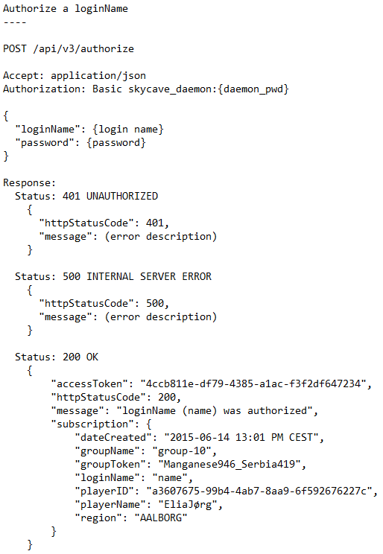
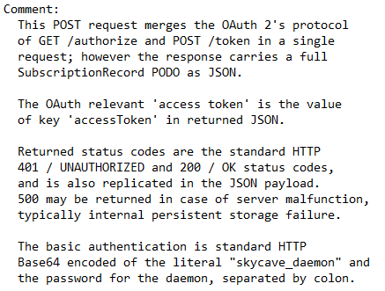
Protocol
Notes:
Source: msdo-e21/resources/authentication

Slide 37
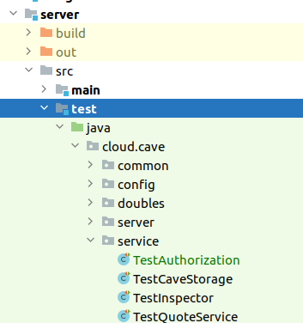
Have a look at
Find a few learning tests in:

Slide 38
Access Token
New access tokens are issued upon each /authorize call
Access token must be presented to each call to a protected resource
It is actually a ‘session id’, identifying the current session a given player has within the cave…
Thus, it is presented to each ‘cmd – daemon’ interaction
Daemon is the protected resource, right…
Access tokens do not expire in our subscription service
At least for now, maybe in the future…
New login => New Access token
Thereby it mimics a session id; the old access token is invalidated…

Slide 39
Access Token
Broker Architecture issue
Broker sends requests to an ‘objectId’ and has no token field
But what is the objectId?
playerId identifies Magnus
accessToken identifies Magnus’ authorization
Is it the one? Is it the other?
Design decision
objectId is a mangling of ‘playerId##accessToken’
Allows identifying ‘dual login’ handling
That is, two+ clients competing to be ‘Magnus’
Daemon needs both to determine this situation…
PlayerId identifies Magnus, token the current session…

Slide 40
Example
Mathilde moves north (with the stub subscription service, which issues tokens like “token#0”)
Note: Not an exercise for you. It is taken care of in the provided code base
Just to justify the design decision…

Slide 41
/introspect
Later in the course, you will be strangling the daemon…
Migrate from a monolith to a set of microservices
Example
Daemon does not handle messages in the room
It asks a MessageService to do that on behalf of it
A down stream service that needs to validate token
But we will return to this later…

Slide 42
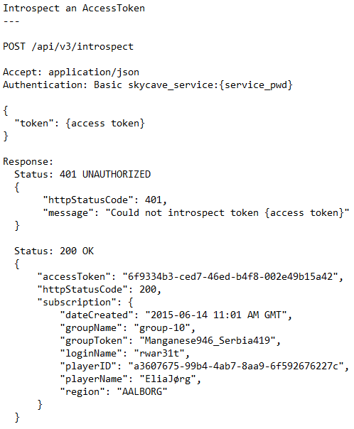
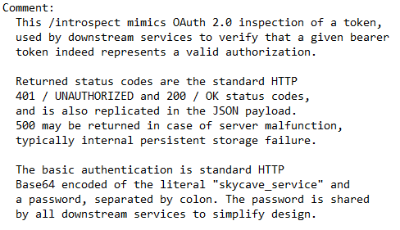
API
A single token for all services
56utxf8tqv

Slide 43
Summary
OAuth 2.0:
A protocol to authorize a client to access a protected resource
Rooted in the HTTP protocol
Without the client knowing the credentials; loose coupling
Parties: Resource owner, Client, AuthSvr, Protected Resource
Central artifact is the access token
Represents the resource owner when client access protected resource
The protocol outlines how the client receives the token
Any client that receives an access token can verify it using the introspection protocol

Slide 44
Summary
In MSDO’s SkyCave systems some simplifications have been made
Credentials are sent to the daemon
POST /authorize
Merges the two requests to get the access token
Client – daemon interactions are via the Broker pattern
objectId is a merge of (playerId, accessToken)
Downstream services can verify a token using POST /introspect

